Slide 1

NATURAL LANGUAGE PROCESSING
Gathering Business insights using NLP

Slide 2
To identify whether a product line needs improvement or not which is based on customers feedback.
Business Problem

Slide 3
AMAZON FINE FOOD REVIEWS (PROJECT 1)
Objective 1
Objective 2
Objective 3
To Identify the sentiments of Review about amazon Fine food
To find out the subjectivity and polarity of Reviews
To find the product value by analysing our reviews.

Slide 4
Challenges and overcoming them
Challenge 1
Challenge 2
Dataset was very large which makes it difficult for us to process and analyse.
Text preprocessing was an issue as our dataset was having emojis.
Challenge 1
Challenge 2
We have to reduce our sample size. Random sample was taken.
We have used demoji library in python which is used to accurately find or remove emojis from a blob of text using data from Unicode Consortium’s emoji code repository.

Slide 5
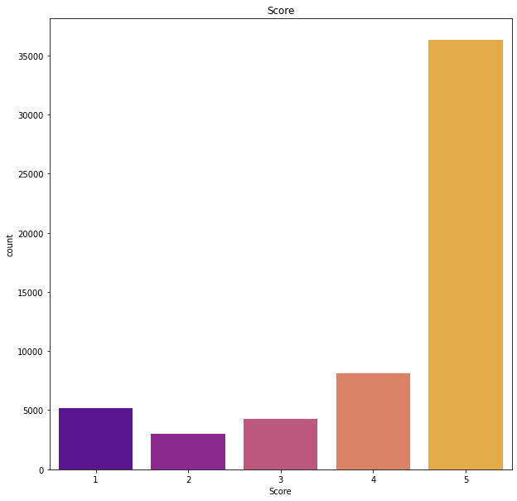
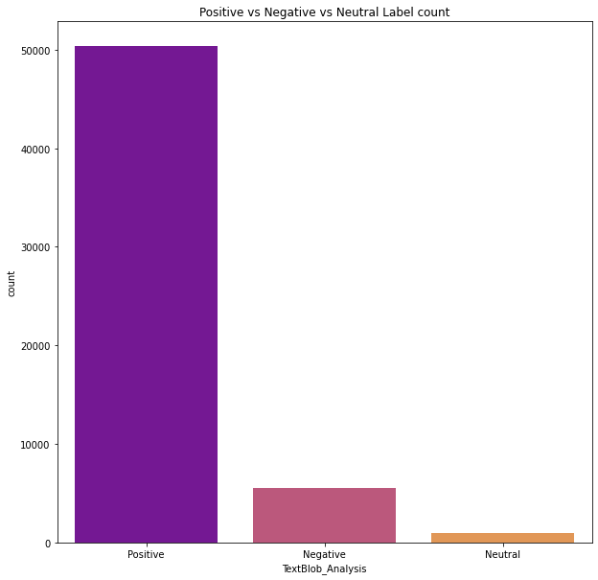
OBSERVATIONS
Reviews are skewed towards positive
More than half of the reviews are with zero votes
Many people agree with score 5 reviews
After text preprocessing we removed the words also, get, one ,since etc as these were not important for sentimental analysis.
After our analysis, we also found that most of the reviews are having positive sentiments.

Slide 6
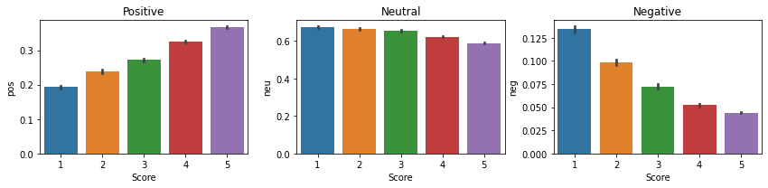
OBSERVATIONS
The highest positive sentiments are coming from score 5 and there are positive sentiments for score as less as 1 and 2 because these reviews might contain a few positive words or may be sarcastic reviews because many people consider themselves as Chandler Bing.
And vice-versa for negative sentiments. Our insights here is that people might be saying a few negative words for example, "the product is good but the service is bad". So, here a small amount of negative sentiment is picked up because while the customer is satisfied with the product and gave score= 5 but, they are not satisfied with the services.

Slide 7
BUSINESS INSIGHTS
Sentiments of a product are directly proportional to the score/rating of the product
This helps in identifying the success/failure of the product.
A higher count of positive sentiments indicates that the product success and vice-versa.
We need to aware of sarcastic comments. To handle sarcastic comments, we need to adopt the advanced NLP engine.

Slide 8
THANK YOU

